Slide 1
"Determining the relative position of the quadcopter from the image"

Slide 2
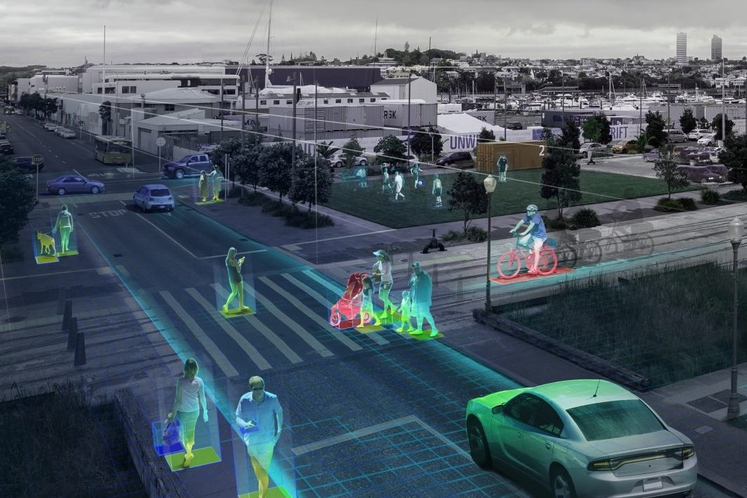
Computer vision

Slide 3
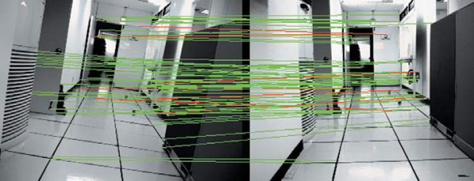
What is the problem?

Slide 4

What tools should we use?

Slide 5
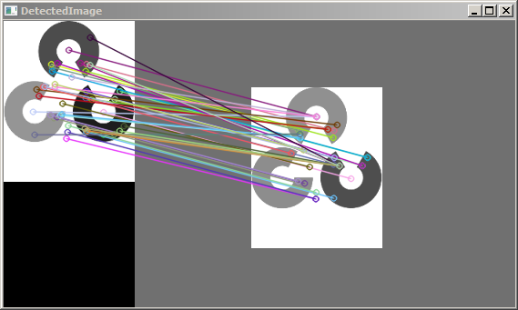
SURF and OpenCV

Slide 6
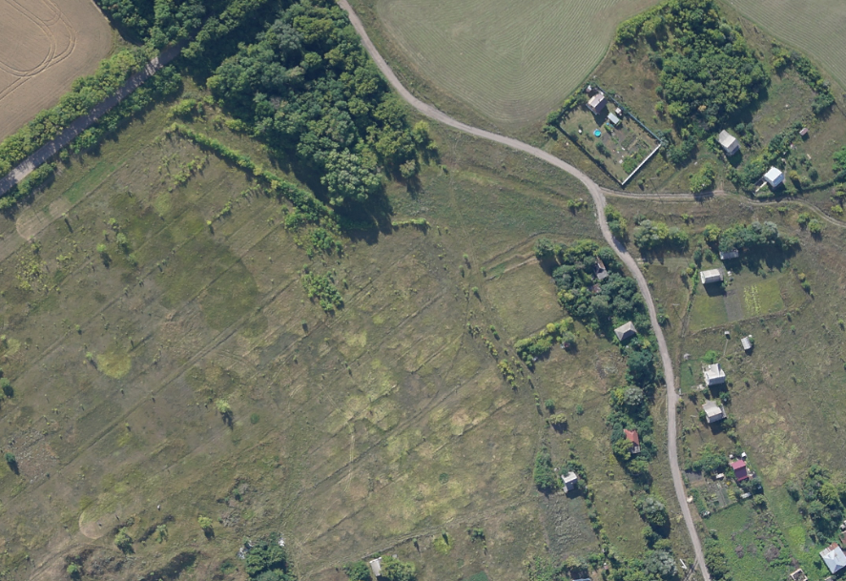

Slide 7
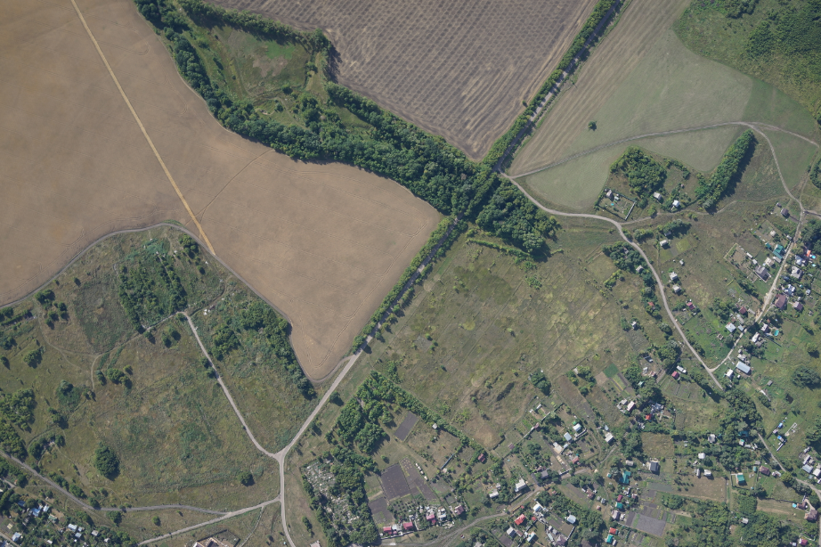

Slide 8
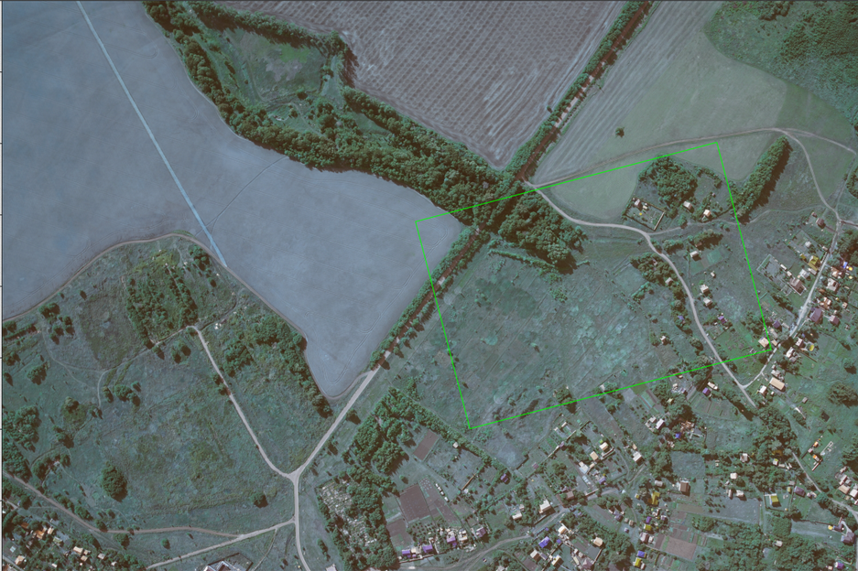

Slide 9
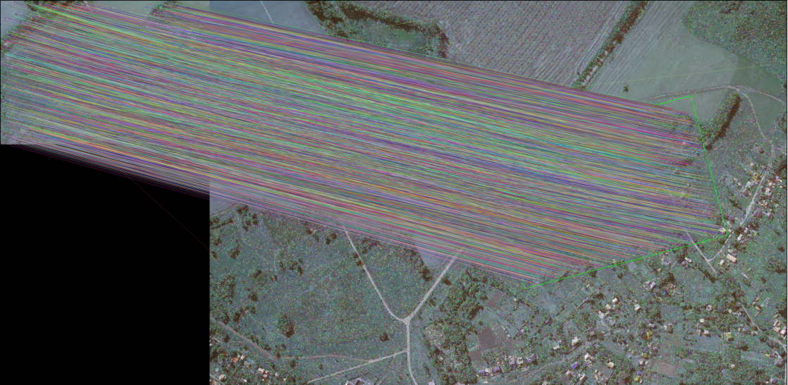

Slide 10


